Slide 1
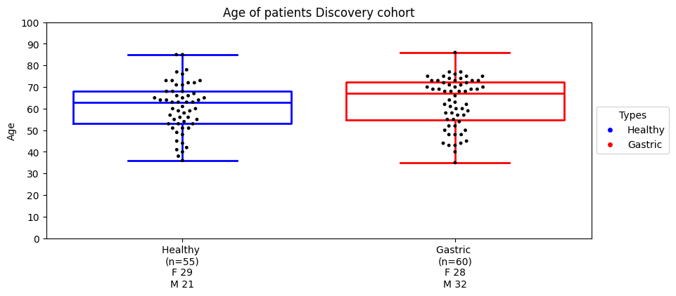
Samples set
Nhóm | HNGH | HNGK | Đã chạy GW non-BS | Đã chạy TMD 450
Tổng | 141 | 193 | - | 115
Healthy | 128 | - | 119 | 55
Giai đoạn sớm | 1 | 141 | 141 | 54
Giai đoạn muộn | - | 21 | 21 | 6
Pre-K | 3 | 10 | 13 | -
Benign | - | 5 | 5 | -
Không nội soi | 5 | - | 4 | -
Khác (di căn, huỷ mẫu) | 4 | 11 | - | -
NA | - | 5 | - | -

Slide 2
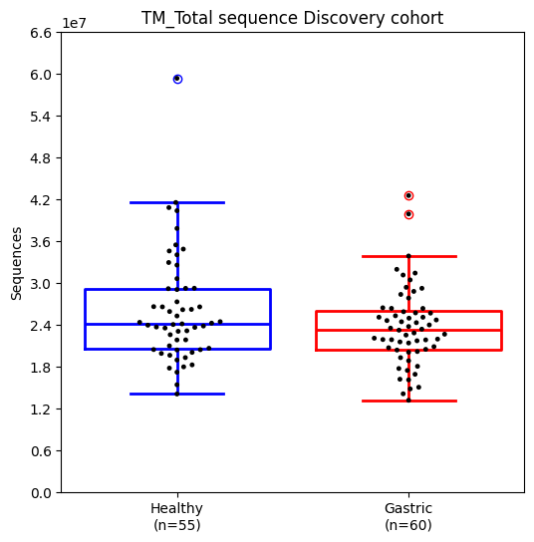
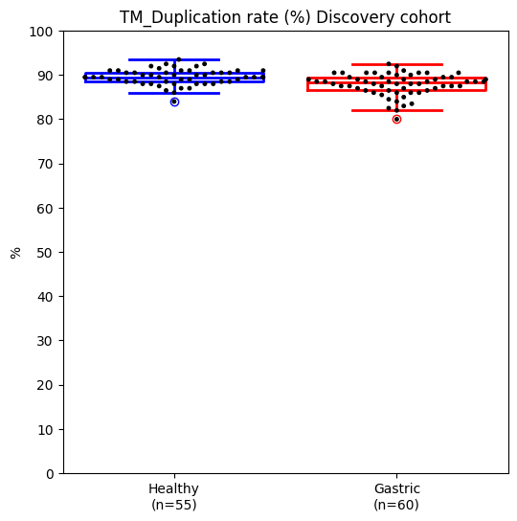
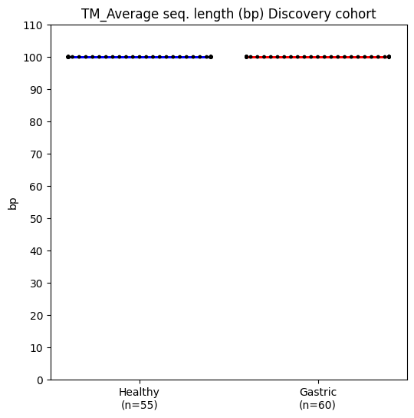
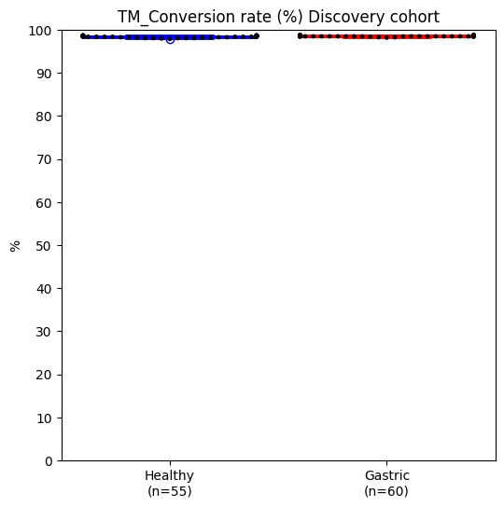
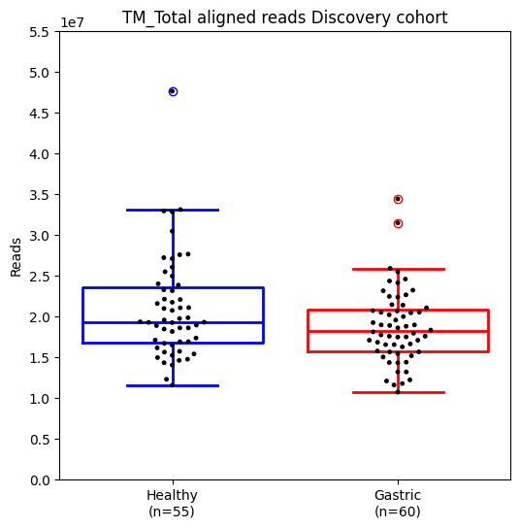
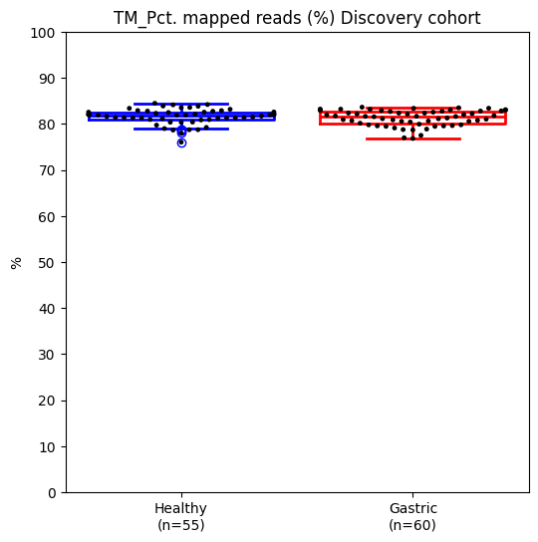
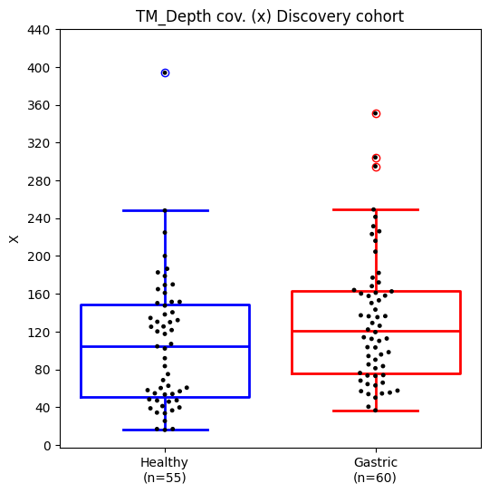
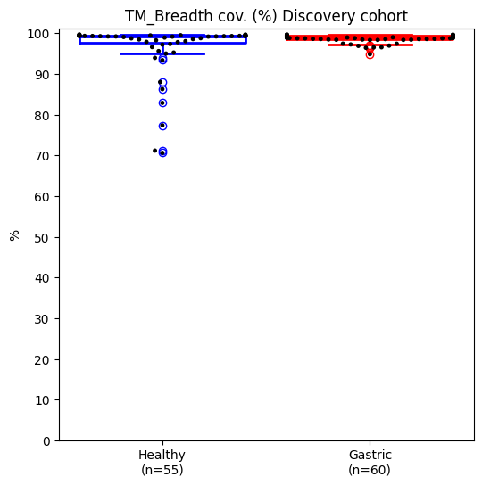
Seq QC: Target fraction

Slide 3
Features
Entropy of flen
Entropy of EM
CNA
Fragment length, Fragement ratio
End motifs
Reads
Ref genome
Target 1
Target 2
Target 3 …

Slide 4
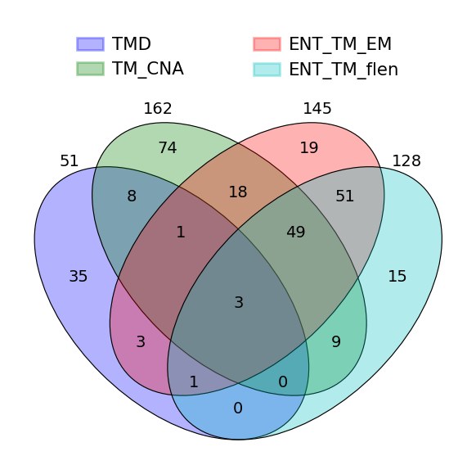
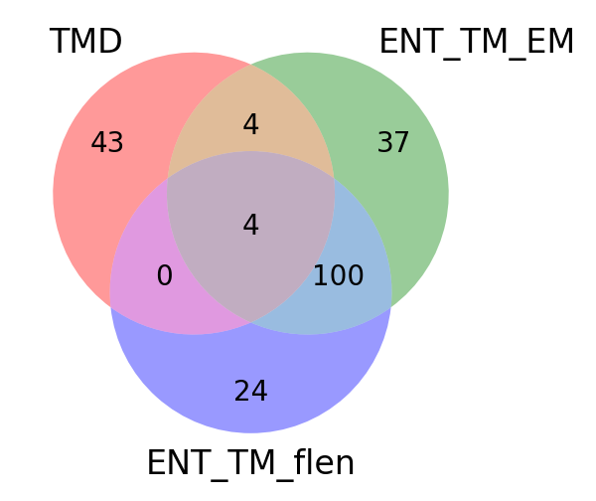
STATS
Number of significantly different features
Pairs | TMD | TM_CNA | TM_RATIO_SHORT_LONG | TM_RATIO_SHORT_TOTAL | TM_flen | TM_EM | ENT_TM_EM | ENT_TM_flen
Healthy vs Gastric | 51 | 162 | 0 | 0 | 18 | 3 | 145 | 128
chrom | feature_name | CHR | start | end | gene
chr6 | TMD_373 | 6 | 1.63E+08 | 1.63E+08 | PARK2_QKI
chr7 | TMD_377 | 7 | 351427 | 351579 | PDGFA_FAM20C
chr11 | TMD_88 | 11 | 62444331 | 62444643 | SCGB1A1_AHNAK
chr17 | TMD_186 | 17 | 58328520 | 58328675 | BZRAP1

Slide 5
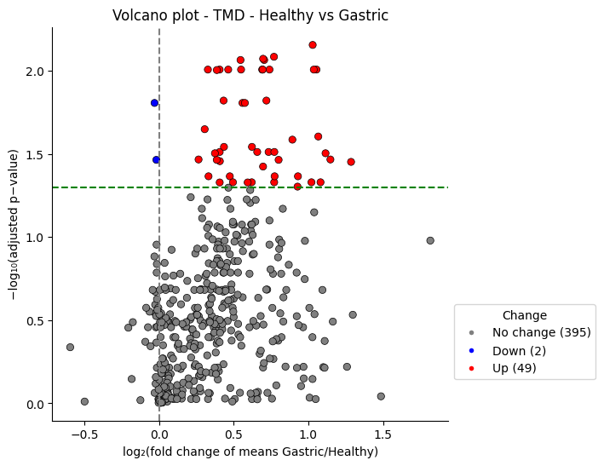
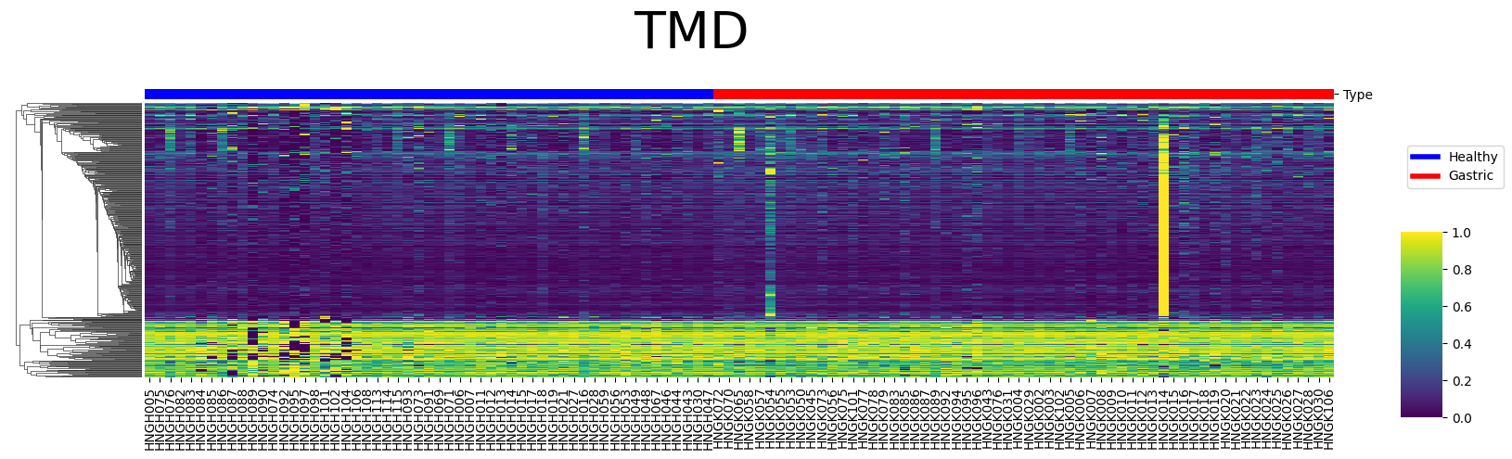
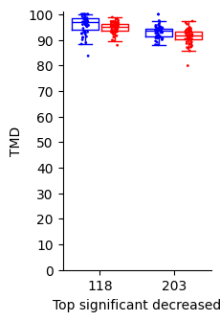
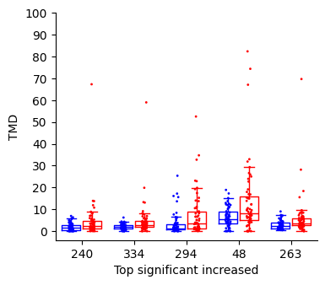
Target methylation density
HNGK054 IIIA with mutation
KRAS_G12R C>G (vaf 16.45)
HNGK014 IIIC

Slide 6
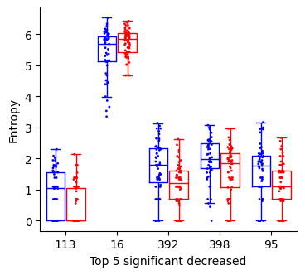
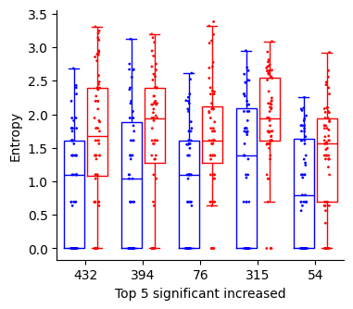
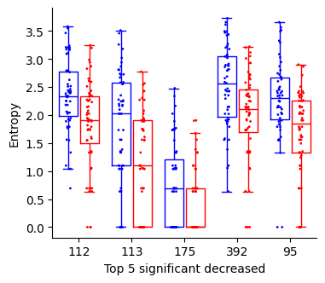
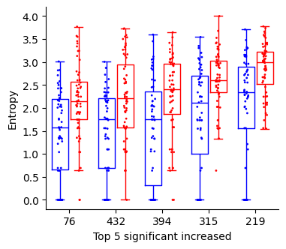
Entropy of EM in each region of 450 target regions
Entropy of flen in each region of 450 target regions

Slide 8
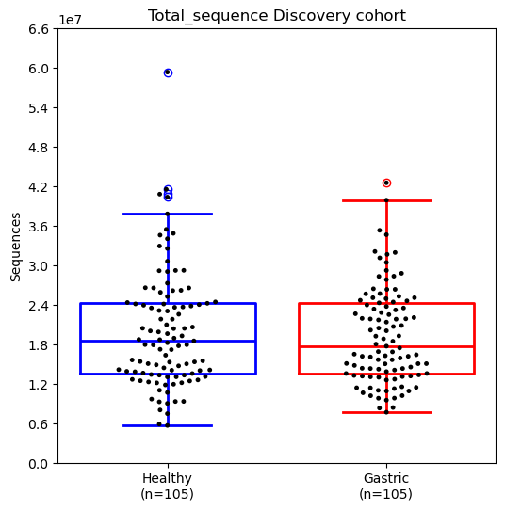
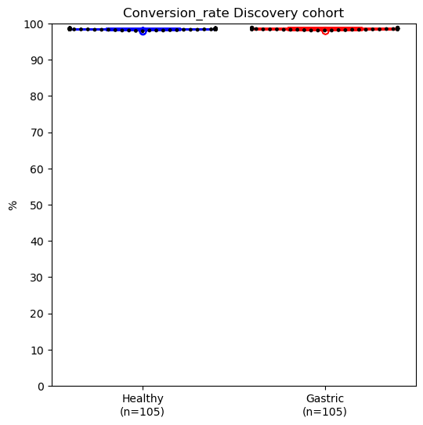
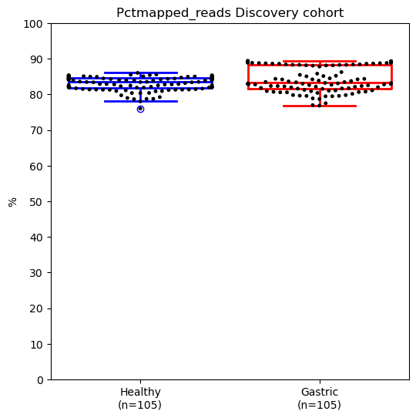
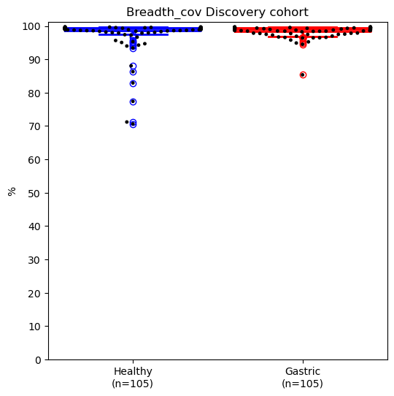
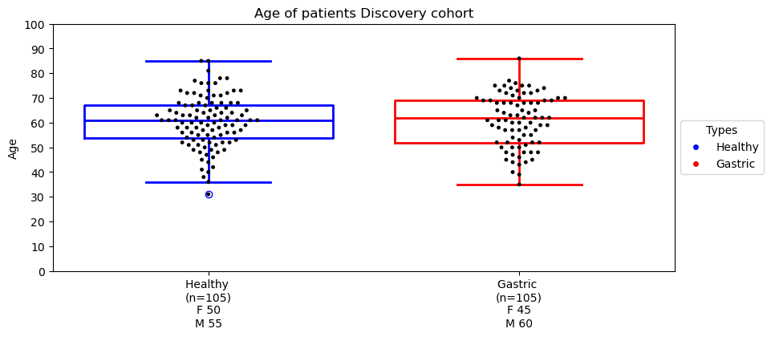
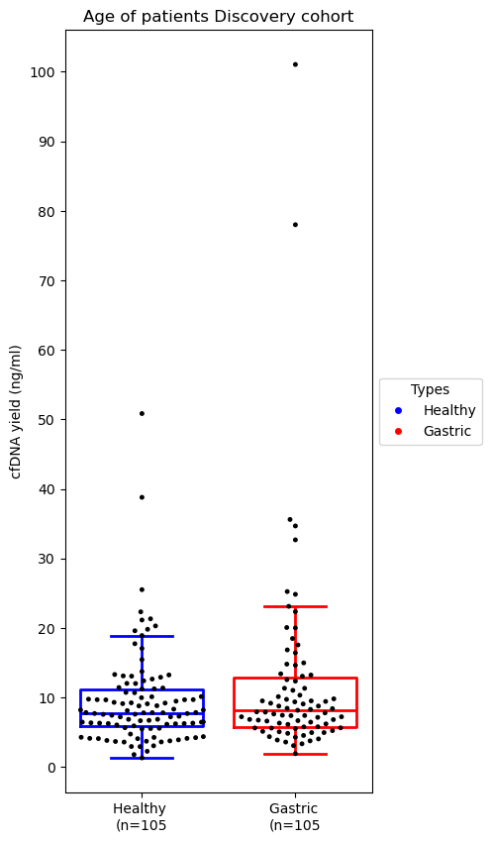
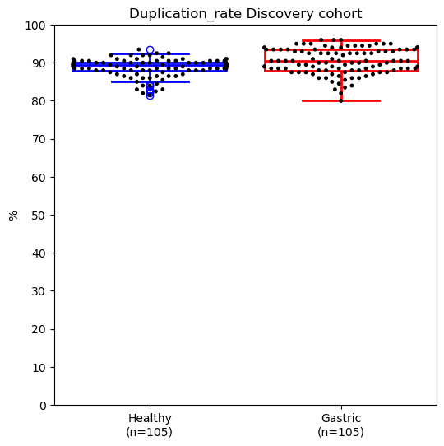
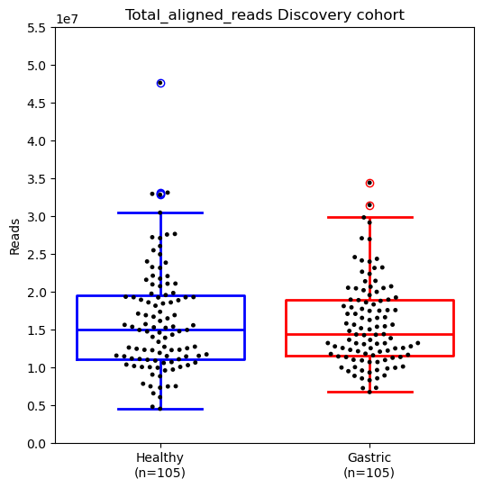
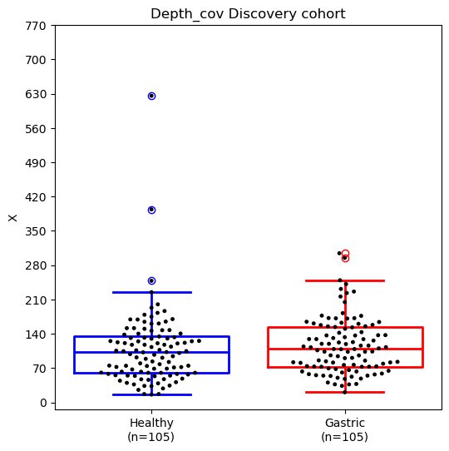
Type | Stage Class | Data available | Waiting | Discovery | Validation
Gastric | Early | 140 | 12 | 105
Gastric | Late | 7
Healthy |  | 114 | 33 | 105
Gastric_benign |  | 5
Healthy_khongnoisoi |  | 3
Gastric_highrisk |  | 1
Samples set

Slide 9
STATS
Pairs | TMD | TM_CNA | TM_RATIO_SHORT_LONG | TM_RATIO_SHORT_TOTAL | TM_flen | TM_EM | ENT_TM_EM | ENT_TM_flen
Healthy vs Gastric | 8 | 74 | 0 | 0 | 6 | 1 | 26 | 0

Slide 10
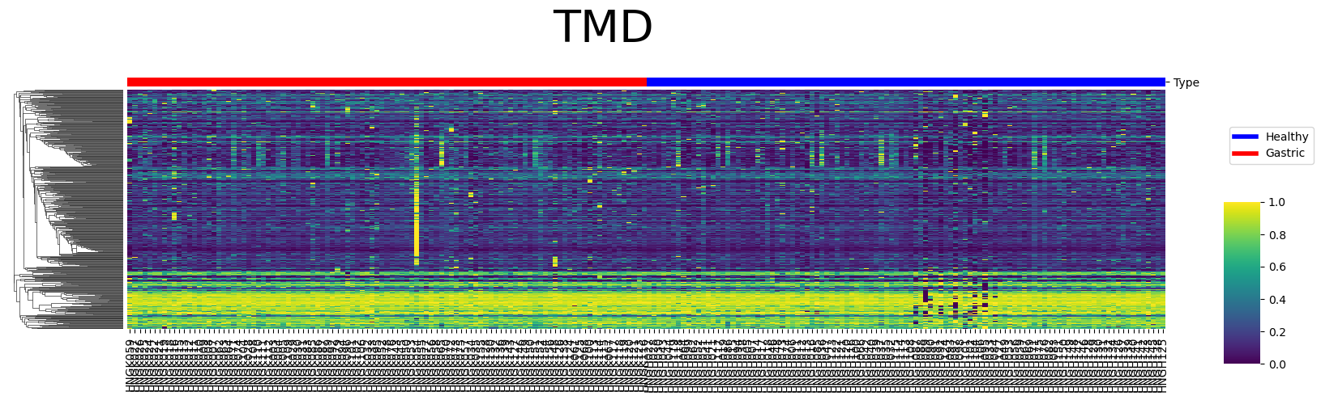
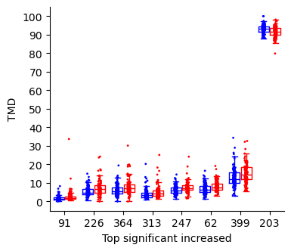
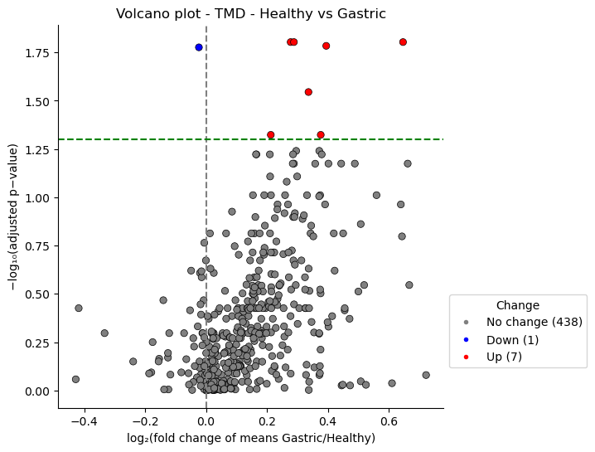

Slide 11
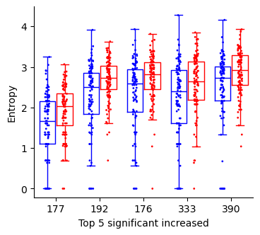
Entropy of EM in each region of 450 target regions

